Slide 1

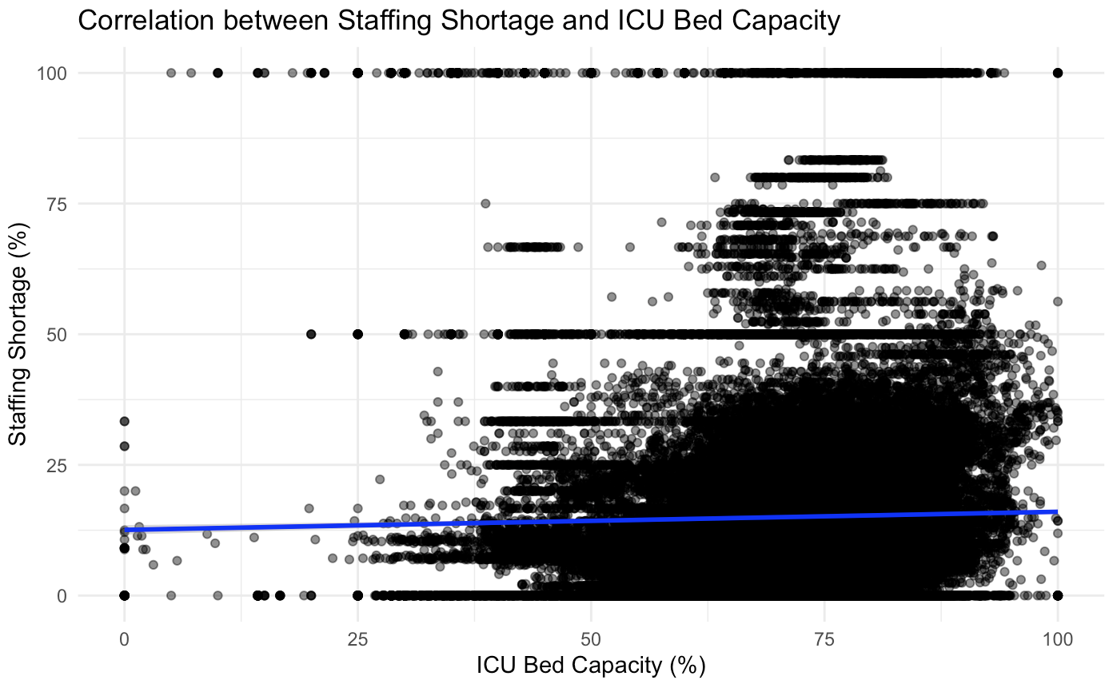
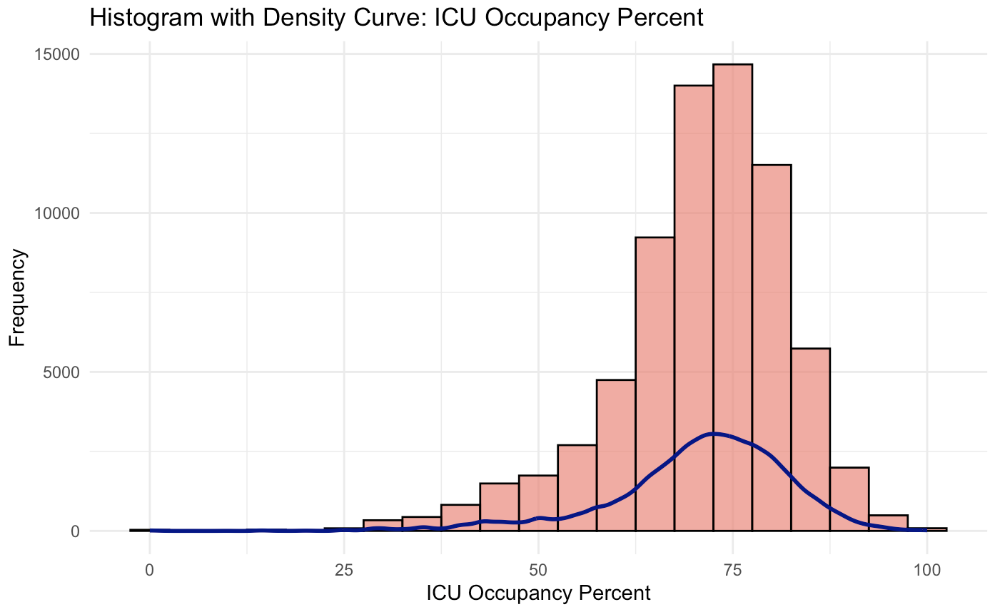
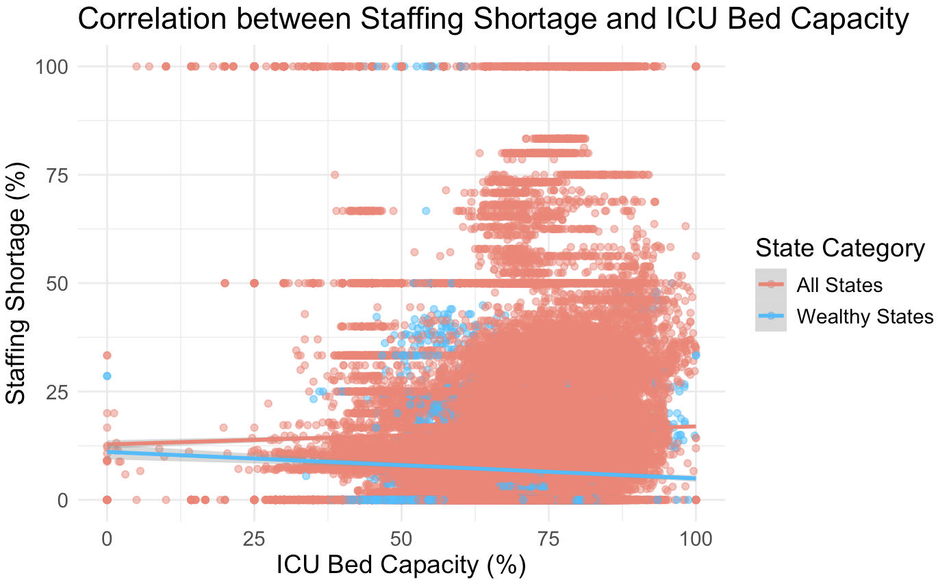
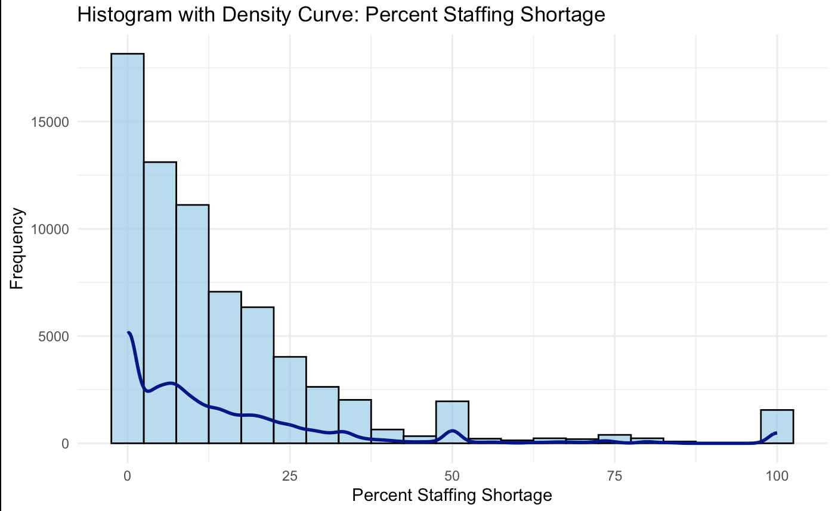
Hospital Staffing Shortages and ICU Bed Occupancy in the United States During the COVID-19 Pandemic
Eric Yao, Jacob Hillman, Ayanna Kakar
ENGRD 302W, Department of Quantitative Science, Emory University Atlanta GA, 30332
Introduction
Intensive Care Unit (ICU) bed capacity and staff availability are key contributors towards a hospital's patient treatment sufficiency (​Landier et al.)
During the first few months of Covid-19, 29% of hospitals reported critical staff shortages and an increase in ICU admittance by 67.8% ​(Kokudo et al.)
Studies report patient mortality nearly doubling with ICU bed occupancy rates of over 85%​ (Our study aims to determine if there is a correlation between ICU bed occupancy and hospital staff shortages via regression analysis, as well as how each variable fluctuated over time and if state-level differences were apparent
A linear regression model was used to assess the relationship between ICU bed occupancy percentage and percent staffing shortage modeled as:
Percent Staffing Shortage=β0​+β1​×ICU Bed Occupancy Percent+ϵ
Results
Fig. 3: Regression of ICU Bed Capacity on Staffing Shortage
Methods
For our study, we utilized data collected by the United States department of Health and Human Services. Two new variables were generated for this dataset: percent ICU occupancy and percent staffing shortage, percent of hospitals with a critical shortage on a given day.
R was used in this study along with the ggplot2, tidyverse, tidyr, purr packages to plot the visualizations.
Fig. 1: Histogram of ICU Occupancy Percent Frequency
Percent Staffing Shortage was created through the manipulation of existing columns:
Blue= Existing
Red=New
percent_shortage = (critical_staffing_shortage_today_yes /
(critical_staffing_shortage_today_yes +
critical_staffing_shortage_today_no)) * 100
Fig. 4: Regression of ICU bed capacity on staffing shortage factorized by average family income of states
Conclusion
While we did find a correlation between percent staffing shortage and ICU bed capacity, it was not a strong relationship. Interestingly, when selecting for only wealthy states, there was no relationship at all between the two variables. Future research could look into possible reasons for this difference.
ICU percent occupancy was created through the manipulation of existing columns:
Blue= Existing
Red=New
icu_occupancy_percent = (staffed_adult_icu_bed_occupancy /
total_staffed_adult_icu_beds) * 100)
References
Fig. 2: Histogram of Percent Staffing Shortage
Landier, J., Paireau, J., Rebaudet, S. et al. Cold and dry winter conditions are associated with greater
SARS-CoV-2 transmission at regional level in western countries during the first epidemic wave. Sci Rep 11, 12756 (2021). https://doi.org/10.1038/s41598-021-91798-9
U.S. Department of Health & Human Services. (n.d.). COVID-19 reported patient impact and hospital capacity by State Timeseries (RAW) [Dataset].
Kokudo N, Sugiyama H. Hospital capacity during the COVID-19 pandemic. Glob Health Med. 2021 Apr 30;3(2):56-59. doi: 10.35772/ghm.2021.01031. PMID: 33937565; PMCID: PMC8071684.

